Slide 1
HIGH SECURITY ENCRYPTION USING AES& VISUAL CRYPTOGRAPHY
Submitted in the partial fulfillment for the award of the degree of
BACHELOR OF ENGINEERING
IN
COMPUTER SCIENCE AND ENGINEERING (INFORMATION SECURITY)
Submitted by:
MENDA MANMADHA RAO – 21BCS3544
PENTAKOTA SRI PRANEETH – 21BCS3523
Under the Supervision of:
PRABJOT SINGH BALI
Department of AIT-CSE
DISCOVER . LEARN . EMPOWER

Slide 2
Index
Introduction to Project
Scope of the Project
Problem Formulation of the Project
Implementation of the Project
Future Scope of the Project

Slide 3
Introduction Of the Project
The introduction will outline the core concepts and significance of the project.
Highlighting the need for advanced encryption techniques in the modern digital landscape.
Exploring the relevance of high-security encryption methods and their crucial role in safeguarding data integrity, confidentiality, and accessibility.

Slide 4
Introduction Of The Project
Definition: AES, or Advanced Encryption Standard, is a symmetric encryption algorithm widely used to secure sensitive data. It operates on fixed block sizes and key lengths of 128, 192, or 256 bits.
Key Features: AES is renowned for its robust security, efficiency, and versatility, making it a cornerstone of modern cryptographic systems.
Applications: AES encryption is employed in various domains, including network security, financial transactions, and data storage.

Slide 5

Introduction Of the Project
This presentation will provide a comprehensive overview of high-security encryption using AES (Advanced Encryption Standard) and visual cryptography.
The combination of these two technologies ensures robust protection of sensitive data and information.
We will delve into various aspects of the project, including problem formulation, objectives, methodology, results, conclusion, future scope, and references

Slide 6
Scope of the Project
A comprehensive study of the AES algorithm and its implementation for text-based data encryption.
An exploration of Visual Cryptography techniques for image-based data.
Integration of AES and Visual Cryptography to develop a dual-secure encryption system.
Performance analysis of the combined system in terms of encryption/decryption speed, security level, and resource consumption.
Development of a user-friendly interface to facilitate the encryption and decryption process for end-users.
Ensuring the system is robust against common security threats and attacks.

Slide 7

AES Encryption Process
AES Encryption Process
Substitution-Permutation Network: AES employs a series of substitution and permutation operations to transform plaintext into ciphertext. This complex process ensures a high level of security.
Key Expansion: The key expansion process generates a set of round keys from the original encryption key, enhancing the algorithm's resistance to cryptanalysis.
Rounds of Encryption: AES operates through multiple rounds of encryption, with the number of rounds determined by the key size. Each round involves distinct operations to obscure the plaintext.

Slide 8
Strengths of AES Encryption
Security Levels: AES offers three distinct security levels based on the key length: 128-bit, 192-bit, and 256-bit. Longer key lengths provide higher security but may impact performance.
Resistance to Attacks: AES has withstood extensive cryptanalysis and is resilient against various attacks, including differential and linear cryptanalysis.
Standardization and Adoption: The widespread adoption of AES as a standard encryption algorithm by governments and organizations underscores its reliability and trustworthiness.

Slide 9
Visual Cryptography
Concept: Visual cryptography involves the encryption of a secret image into shares, which individually reveal no information about the original image. When the shares are superimposed, the original image is visually revealed.
Share Creation: Visual cryptography generates shares using a special encoding technique, ensuring that no share provides any clue about the original image.
Decryption Process: The decryption of the secret image is achieved by stacking the shares, allowing the human visual system to perceive the original image without the need for complex computations.

Slide 10
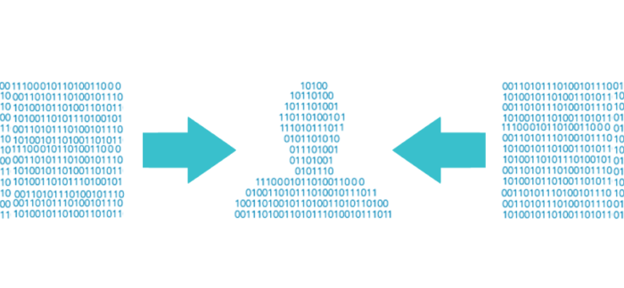
Perfect Secrecy: Visual cryptography achieves perfect secrecy, as no single share contains any information about the original image. This property is crucial for secure image encryption.
No Complex Decryption: Unlike traditional cryptographic methods, visual cryptography requires no complex computations for decryption, making it suitable for applications where simplicity is paramount.

Slide 11

Problem Formulation
Challenges :
Secure AES Key Exchange: Develop a secure mechanism for exchanging AES keys between communicating parties to prevent unauthorized access to the symmetric key
Image Encryption with AES: Implement a robust method to encrypt images using AES, ensuring that the confidentiality of visual data is maintained

Slide 12
Decryption Algorithm: Design an efficient algorithm for decrypting the original image using the combined information from AES decryption and Visual Cryptography
Visual Cryptography Scheme: Design a Visual Cryptography scheme that efficiently divides encrypted images into shares, ensuring that individual shares reveal no information about the original content.
Key Management: Establish a secure key management system to handle the lifecycle of AES keys, including generation, distribution, and storage

Slide 13
Implementation of the Project
AES ENCRYPTION :
Convert plain text to binary .
Generate a random AES key .
Encrypt binary message using AES to produce ciphertext
VISUAL CRYPTOGRAPY:
Divide AES ciphertext into shares(images).
Generate random pixel patterns for each share .
Apply patterns using bitwise XOR on corresponding pixels.
Distribute shares to recipients.

Slide 14
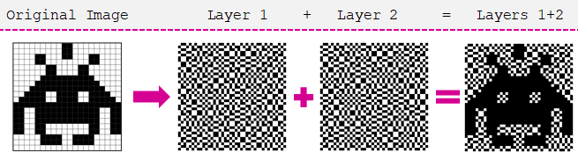
DECRYPTION :
Collect shares from recipients.
Stack shares to reveal portions of the secret.
Recipients XOR their share with the combined share.
Decrypt resulting AES ciphertext with the AES key to get the plaintext

Slide 15
Future Scope of the Project
Advanced Encryption Applications | Exploring potential integration into diverse digital systems and platforms, from cloud-based solutions to IoT frameworks.
Security Standardization | Discussing the prospects of establishing new security benchmarks and standards based on the project's methodologies and outcomes.

